Slide 1
Group No. 23
IIT2018001 IIT2018007 IIT2018008 IIT2018031 IIT2018069

Slide 2
Key Management in PGP and S/MIME

Slide 3
What is PGP encryption ?
PGP stands for ​Pretty ​Good ​Privacy.
It allows people to communicate privately online.
Example:
When A sends a message to B using PGP, the text is first converted to a ciphertext which can only be accessed using a key.
This key is present with the receiver who is able to convert the ciphertext back to the intended text. PGP uses a combination of ​symmetric key encryption

Slide 4
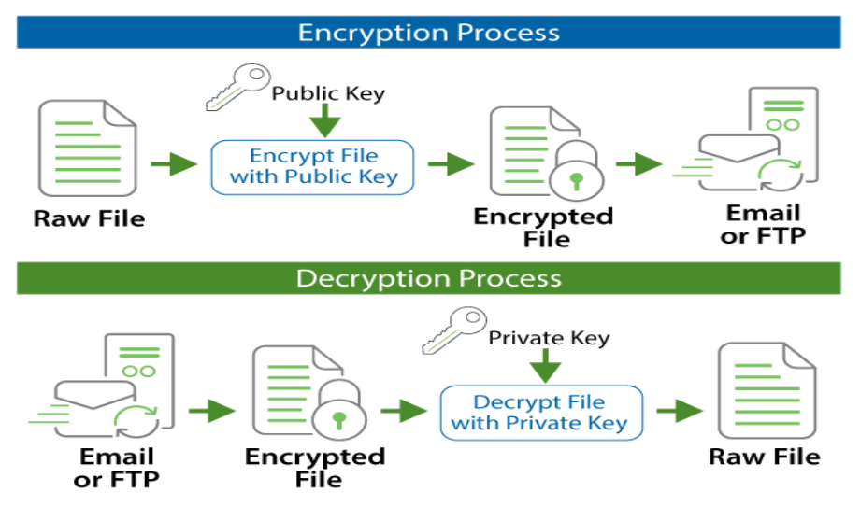

Slide 5
Steps involved in PGP:
1.The first thing PGP does is generate a random session key.
2.Next, the session key is encrypted using the recipient’s public key.
3.When the recipient receives an encrypted message, they decrypt the session key using their private key.The plain text session key then decrypts the message.
4.PGP combines the efficiency of symmetric encryption and the convenience of public key encryption.
5.A digital signature proves to the recipient that an attacker has not manipulated the message or the sender

Slide 6
What is S/MIME encryption ?
It is based on asymmetric cryptography.
It is not possible to figure out the private key based on the public key.
It allows you to leave your digital signature on your mail so that when the recipient uses your public key for decrypting it, they are able to verify that the email really came from you.
It provides the authentication, message integrity and non-repudiation of origin and data security services for electronic data transmission applications.

Slide 7
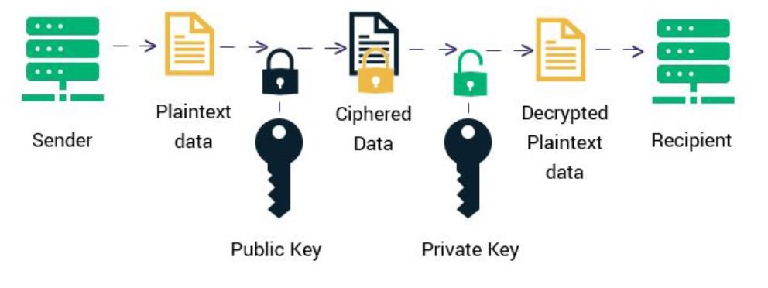

Slide 8
Differences:
1.PGP allows one user to directly give a public key to another user or vice versa. In PGP each user is allowed to decide the length of trust in the received keys. InS/MIME, the sender or receiver does not reply on exchanging the keys in advance and share a common certifier on which they rely.
2.Since PGP protocol was developed to handle plain email or text messages and depends on each user’s key exchange. S/MIME uses hierarchically validated certifier for key exchange.
3.PGP contains 4096 public keys whereas S/MIME has 1024 public keys

Slide 9
Thank you !

